Slide 1






M
I
Theoretical Framework for machine Learning Researcher
Dr. Myo Myint Oo
Ph.D. (Computer Engineering) , PSU , Thailand

Slide 2


Table Of Contents
ML with me
Theoretical Framework for ML

Slide 3

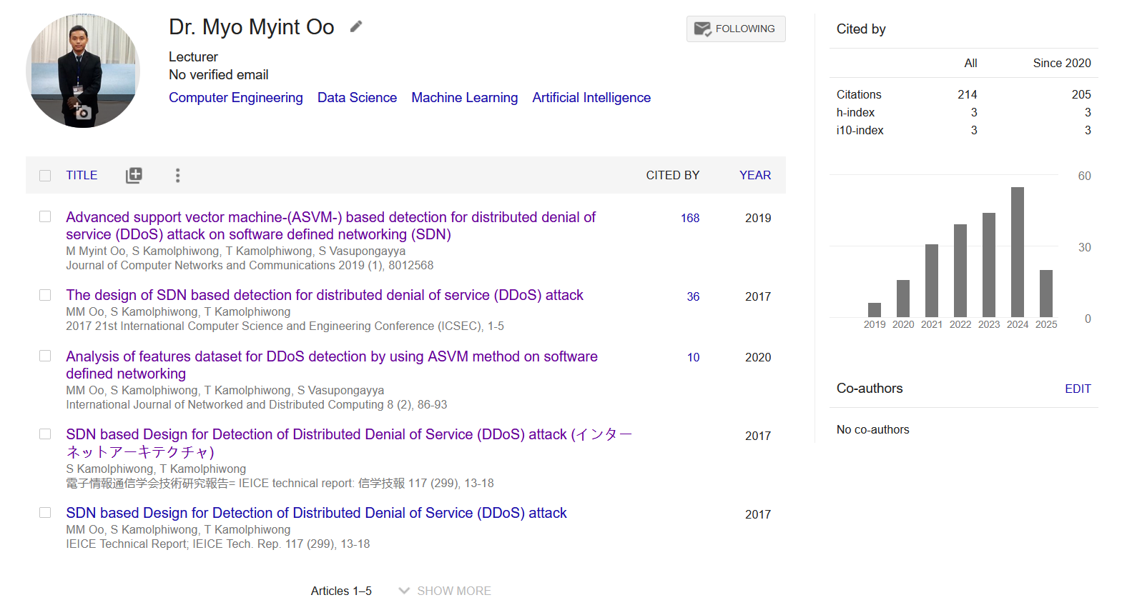
ML with Me

Slide 4

What is Theoretical Framework?
A theoretical framework is a foundational review of existing theories that serves as a roadmap for developing the arguments you will use in your own work.
Why
How

Slide 5

Theoretical Framework for ML
Statistical Learning Theory
Optimization Theory
Information Theory
Algorithmic Computational Complexity

Slide 6
Statistical Learning Theory
Framing the problem
Data Understanding
Data Cleaning
Data selection and preparation
Model evaluation
Configuration of the model
Model selection and presentation
Model predictions

Slide 7
Optimization Theory in Machine Learning
Optimization Theory in machine learning are mathematical techniques used to adjust a model's parameters to minimize errors and improve accuracy.
This can help models learn from data by finding the best possible solution through iterative updates.

Slide 8
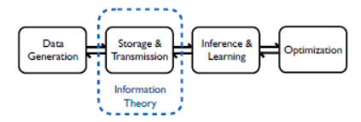
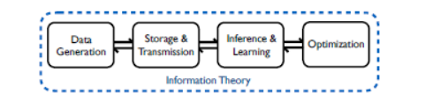
Information theory and Data
Information theory is a theory of communication
Information theory is a theory of communication

Slide 9
Key Concepts of Information Theory
Entropy measures the uncertainty or unpredictability of a random variable. In machine learning, entropy quantifies the amount of information required to describe a dataset.
Mutual information measures the amount of information obtained about one random variable through another random variable. It quantifies the dependency between variables.

Slide 10
Algorithmic Computational Complexity
Algorithmic computational complexity is the measure of the resources, typically time and space, an algorithm requires relative to its input size.
It helps analyze and compare the efficiency of algorithms, focusing on how their performance scales with increasing input.
This is often expressed using Big-O notation to describe the upper bound or "worst-case" performance, as seen in functions like \(O(n)\) (linear) or \(O(n^{2})\) (quadratic)

Slide 11
Summary
“Theory is what turns data into knowledge”
:

Slide 12
References
Shalev-Shwartz, S., & Ben-David, S. (2014). Understanding Machine Learning: From Theory to Algorithms. Cambridge University Press. → A foundational book covering learning theory, PAC learning, and generalization.
Goodfellow, I., Bengio, Y., & Courville, A. (2016). Deep Learning. MIT Press. → Explains deep learning models and the theoretical principles behind them.
Jordan, M. I., & Mitchell, T. M. (2015). “Machine Learning: Trends, Perspectives, and Prospects.” Science, 349(6245), 255–260. → Discusses theoretical and empirical research trends in ML.
Bishop, C. M. (2006). Pattern Recognition and Machine Learning. Springer. → Covers probabilistic and information-theoretic frameworks in ML.
Vapnik, V. N. (1998). Statistical Learning Theory. Wiley. → Introduces the theoretical foundation of modern ML through statistical learning theory and VC dimension.

Slide 13

Thank you!

